Slide 1
CUDA Parallelism Model
Slide credit: Slides adapted from
© David Kirk/NVIDIA and Wen-mei W. Hwu, 2007-2016

Slide 2

Notes:
Poll Title: Favorite Quarantine Activity
https://www.polleverywhere.com/free_text_polls/ybjbYhrU7zfjC4UGMIRDi

Slide 3
Logistics
My office hours
  Wed/Thu 1:00pm-2:00pm
TA office hours
  Friday 3:00pm-5:00pm
Quiz Next Class – Wednesday 15th
Lab 1 Due next Friday – 24th

Slide 4

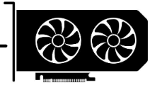


GPU in PC Architecture
Computer System is made up of various components that want to send data to each other
Connect everything through bus system
2

Slide 5
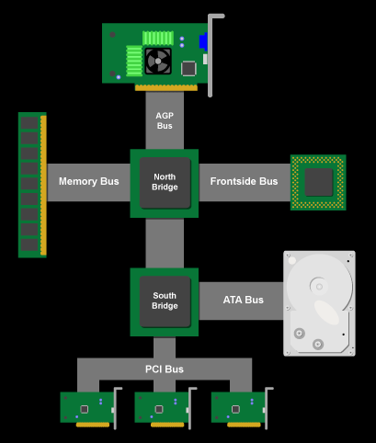
History: Classic PC architecture
Northbridge connects 3 components that must communicate at high speed
  CPU, DRAM, video
  Video also needs to have 1st-class access to DRAM
  Previous NVIDIA cards are connected to AGP, up to 2 GB/s transfers
Southbridge serves as a concentrator for slower I/O devices
CPU
Core Logic Chipset

Slide 6
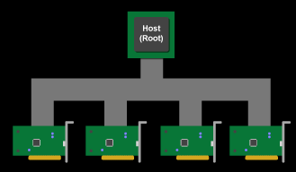
(Original) PCI Bus Specification
Connected to the Southbridge
  Originally 33 MHz, 32-bit wide, 132 MB/second peak transfer rate
  More recently 66 MHz, 64-bit, 528 MB/second peak
  Upstream bandwidth remain slow for device (~256 MB/s peak)
  Shared bus with arbitration
    Winner of arbitration becomes bus master and can connect to CPU or DRAM through the Southbridge and Northbridge`

Slide 7
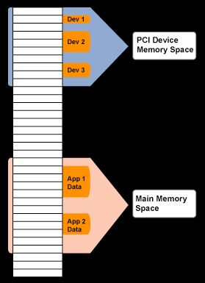
PCI as Memory Mapped I/O
PCI device registers are mapped into the CPU’s physical address space
  Accessed through loads/ stores (kernel mode)
Addresses are assigned to the PCI devices at boot time
  All devices listen for their addresses

Slide 8
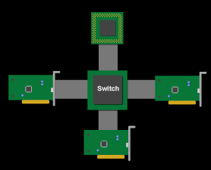
PCI Express (PCIe)
Switched, point-to-point connection
  Each card has a dedicated “link” to the central switch, no bus arbitration
  Packet switches messages form virtual channel
  Prioritized packets for QoS
    E.g., real-time video streaming

Slide 9
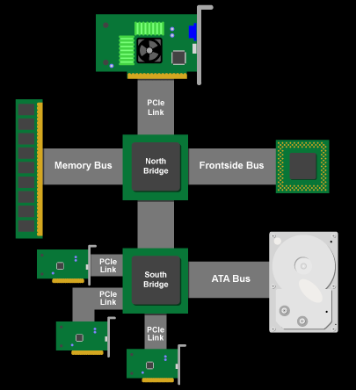
PCIe PC Architecture
PCIe forms the interconnect backbone
Northbridge and Southbridge are both PCIe switches
Some Southbridge designs have built-in PCI-PCIe bridge to allow old PCI cards
Some PCIe I/O cards are PCI cards with a PCI-PCIe bridge

Slide 10
PCIe Specifications
PCIe 3
  8 Giga Transfers per second bi-directional
  985 MB/s (x1)
  15.75 GB/s (x16)
PCIe 4
  16 Giga Transfers bi-directional
  1.97 GB/s (x1)
  31.5 GB/s (x16)

Slide 11
Key Takeaways
GPUs are peripheral devices within a computer system
Data is transferred from CPU to GPU through PCIe links

Slide 12
Writing a GPU program

Slide 13
GPU Hierarchies
 | Scalar | Vector | Core | Card
Hardware
 | ALU Unit | SIMD Unit | SM | GPU
Threads
 | Thread | Warp | Thread Block | Block Grid
Memory | Register File |  | L1 Cache | L2 / Memory
Address Space | Local per thread |  | Shared Memory | Global
ALU
SM
SM
ALU
SIMD
2

Slide 14
CUDA programming language
Compute Unified Device Architecture (CUDA) is Nvidia’s programming interface for General Purpose Graphics Processing Units
CUDA is written in C/C++
  Other languages provide a wrapper around this
Provides both a low-level driver api and high-level runtime api
  We will be working with runtime api
  Runtime API is simpler and easier to use but lacks device level control of the driver api
Includes the Nvidia C Compiler (NVCC)
  NVCC is the only way to compile device (GPU) code for nvidia GPUs
  Contains GCC underneath to compile host (CPU) code
repeat
as needed

Slide 15
Compiling A CUDA Program
Integrated C programs with CUDA extensions
NVCC Compiler
Device Code (PTX)
Host Code
Host C Compiler/ Linker
Device Just-in-Time Compiler
Heterogeneous Computing Platform with
CPUs, GPUs, etc.

Slide 16
Phases of GPU programs
Setup / Memory Allocation
Host Code
repeat
as needed
Host to Device Mem Copy
Kernel Execution
Device Code
Host Code
Device to Host Mem Copy

Slide 17
Setup / Memory Allocation
// Host code
int main()
{
int N = ...;
size_t size = N * sizeof(float);
// Allocate input vectors h_A and h_B in host memory
float* h_A = (float*)malloc(size);
float* h_B = (float*)malloc(size);
// Initialize input vectors
...
// Allocate vectors in device memory
float* d_A;
cudaMalloc(&d_A, size);
float* d_B;
cudaMalloc(&d_B, size);
float* d_C;
cudaMalloc(&d_C, size);
Allocate memory in both host and device
Standard Malloc for host allocations
cudaMalloc(ptr,size) for device allocation
This means you have two pointers to handle

Slide 18
Host to Device Mem Copy
// Host code
int main()
{
…
// initialize host memory data
for(int i = 0; i< n;i++) {
h_A[i] = rand()
h_B[i] = rand()
}
// Copy vectors from host memory to device memory
cudaMemcpy(d_A, h_A, size,cudaMemcpyHostToDevice); cudaMemcpy(d_B, h_B, size,cudaMemcpyHostToDevice);
Once memory is allocated initialize host memory data
Then copy host data to device with cudaMemcpy(src,dest,cudaMemcpyHostToDevice)

Slide 19
Memory Allocation and memory copy
cudamalloc
malloc
DRAM
Global
Memory
repeat
as needed
CPU
GPU
cudamemcpy

Slide 20
Kernel Launch and Execution
// Device code
__global__ void VecAdd(float* A, float* B, float* C, int N)
{
int i = blockDim.x * blockIdx.x + threadIdx.x;
if (i < N) C[i] = A[i] + B[i];
}
// Host code
int main()
{
…
// Set block size and grid size
int threadsPerBlock = 256;
int blocksPerGrid =
(N + threadsPerBlock - 1) / threadsPerBlock;
Dim3 blockSize(threadsPerBlock,1,1);
Dim3 girdSize(blocksPergrid,1,1);
VecAdd<<<gridSize, blockSize>>>(d_A, d_B, d_C, N);
…
Device functions are declared with __global__ specifier
Pass allocated device pointers as arguments
Specify grid and block size using Dim3 struct
  Dim3 name(x,y,z)
Launch kernel with func<<<grid,block>>>(args)
Launching a kernel is a non-blocking call
  This means the CPU can continue while the kernel is executing

Slide 21
Kernel execution in a nutshell
__host__
void vecAdd(…)
{
dim3 DimGrid(ceil(n/256.0),1,1);
dim3 DimBlock(256,1,1);
vecAddKernel<<<DimGrid,DimBlock>>>(d_A,d_B,d_C,n);
}
__global__
void vecAddKernel(float *A,
float *B, float *C, int n)
{
int i = blockIdx.x * blockDim.x
+ threadIdx.x;
if( i<n ) C[i] = A[i]+B[i];
}
Grid
Blk 0
Blk N-1
• • •
GPU
M0
• • •
Mk
RAM

Slide 22
// Compute vector sum C = A + B
// Each thread performs one pair-wise addition
__global__
void vecAddKernel(float* A, float* B, float* C, int n)
{
int i = threadIdx.x+blockDim.x*blockIdx.x;
if(i<n) C[i] = A[i] + B[i];
}

Slide 23
More on CUDA Function Declarations
Executed on the:
Only callable from the:
__device__ float DeviceFunc()‏
device
device
__global__ void KernelFunc()‏
device
host
__host__ float HostFunc()‏
host
host
__global__ defines a kernel function
  Each “__” consists of two underscore characters
  A kernel function must return void
__device__ and __host__ can be used together
__host__ is optional if used alone

Slide 24
Device to host Mem copy
// Device code
__global__ void VecAdd(float* A, float* B, float* C, int N)
{
int i = blockDim.x * blockIdx.x + threadIdx.x;
if (i < N) C[i] = A[i] + B[i];
}
// Host code
int main()
{
…
// Copy result from device memory to host memory
// h_C contains the result in host memory
cudaMemcpy(h_C, d_C, size, cudaMemcpyDeviceToHost);
// Free device memory
cudaFree(d_A);
cudaFree(d_B);
cudaFree(d_C);
// Free host memory
...
Once Kernel execution is complete copy results from device to host memory
cudaMemcpy(src,dest,cudaMemcpyDevicetoHost)
Free device memory using cudaFree(ptr)

Slide 25
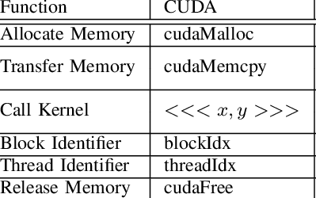
Typical Structure of a CUDA Program
Function prototypes
  __global__ void kernelOne(…)
Main ()
  allocate memory space on the device – cudaMalloc(&d_GlblVarPtr, bytes )
  transfer data from host to device – cudaMemCpy(d_GlblVarPtr, h_Gl…)
  execution configuration setup
  kernel call – kernelOne<<<execution configuration>>>( args… );
  transfer results from device to host – cudaMemCpy(h_GlblVarPtr,…)
repeat
as needed

Slide 26

Notes:
Poll Title: If a kernel launch is non-blocking on the CPU side, what happens if we cudaMemcpyDevicetoHost before the kernel finishes executing?
https://www.polleverywhere.com/free_text_polls/GZJHdE63wum1w1WlP26As

Slide 27
Multi-dimensional Kernel Configuration

Slide 28
A Multi-Dimensional Grid Example
host
device
Grid 1
Block (0, 0)
Block (0, 1)
Kernel 1
Block (1, 0)
Block (1, 1)
Block (1,0)
Grid 2
(1,0,0)
(1,0,1)
(1,0,2)
(1,0,3)
Thread
(0,0,0)
Thread
(0,0,1)
Thread
(0,0,2)
Thread
(0,0,3)
Thread
(0,0,0)
Thread
(0,1,3)
Thread
(0,1,0)
Thread
(0,1,1)
Thread
(0,1,2)
28

Slide 29



Slide 30
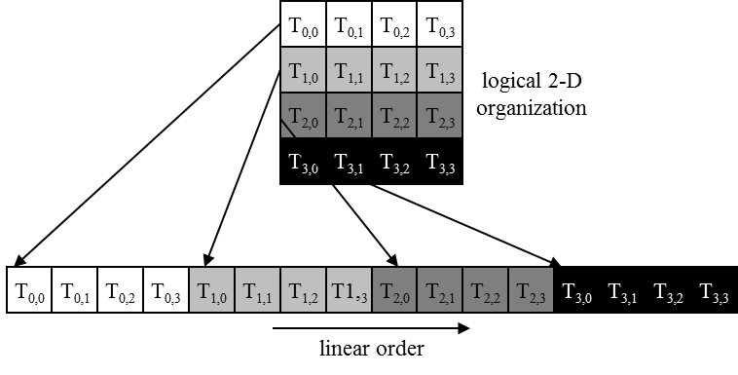
Warps in Multi-dimensional Thread Blocks
The thread blocks are first linearized into 1D in row major order
  In x-dimension first, y-dimension next, and z-dimension last

Slide 31
Row-Major Layout in C/C++
M
Row*Width+Col = 2*4+1 = 9
M₀
M₁
M₂
M₃
M₄
M₅
M₆
M₇
M₈
M₉
M₁₀
M₁₁
M₁₂
M₁₃
M₁₄
M₁₅
M
M_{0,0}
M_{0,1}
M_{0,2}
M_{0,3}
M_{1,0}
M_{1,1}
M_{1,2}
M_{1,3}
M_{2,0}
M_{2,1}
M_{2,2}
M_{2,3}
M_{3,0}
M_{3,1}
M_{3,2}
M_{3,3}
M_{0,0}
M_{0,1}
M_{0,2}
M_{0,3}
M_{1,0}
M_{1,1}
M_{1,2}
M_{1,3}
M_{2,0}
M_{2,1}
M_{2,2}
M_{2,3}
M_{3,0}
M_{3,1}
M_{3,2}
M_{3,3}

Slide 32
Blocks are partitioned after linearization
Linearized thread blocks are partitioned
  Thread indices within a warp are consecutive and increasing
  Warp 0 starts with Thread 0
Partitioning scheme is consistent across devices
  Thus you can use this knowledge in control flow
DO NOT rely on any ordering within or between warps
  If there are any dependencies between threads, you must __syncthreads() to get correct results (more later).

Slide 33
SIMD Execution Among Threads in a Warp
All threads in a warp must execute the same instruction at any point in time
  Also called SIMT execution model
This works efficiently if all threads follow the same control flow path
  All if-then-else statements make the same decision
  All loops iterate the same number of times
Notes:
WARP_SIZE

Slide 34
Device Code Example
__global__ void PictureKernel(float* d_Pin, float* d_Pout,
int height, int width)
{
// Calculate the row # of the d_Pin and d_Pout element
int Row = blockIdx.y*blockDim.y + threadIdx.y;
// Calculate the column # of the d_Pin and d_Pout element
int Col = blockIdx.x*blockDim.x + threadIdx.x;
// each thread computes one element of d_Pout if in range
if ((Row < height) && (Col < width)) {
d_Pout[Row*width+Col] = 2.0*d_Pin[Row*width+Col];
}
}
Scale every pixel value by 2.0

Slide 35
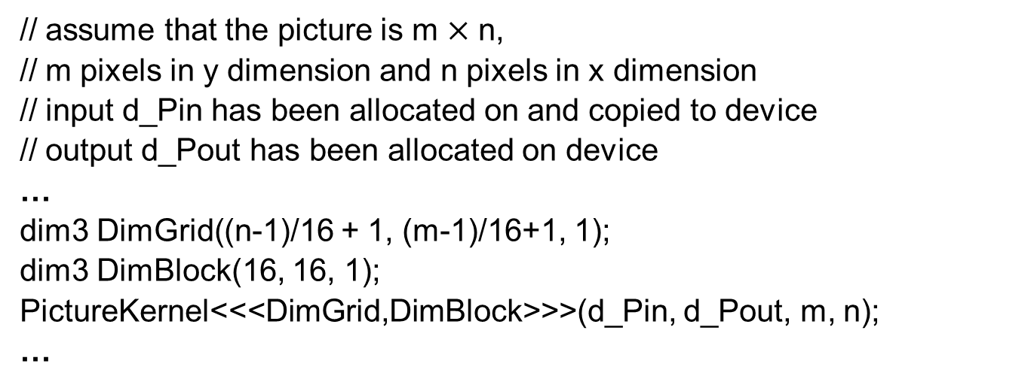
Host Code for Launching PictureKernel
// assume that the picture is m$×$n,
// m pixels in y dimension and n pixels in x dimension
// input d_Pin has been allocated on and copied to device
// output d_Pout has been allocated on device
…
dim3 DimGrid((n-1)/16 + 1, (m-1)/16+1, 1);
dim3 DimBlock(16, 16, 1);
PictureKernel<<<DimGrid,DimBlock>>>(d_Pin, d_Pout, m, n);
…

Slide 36
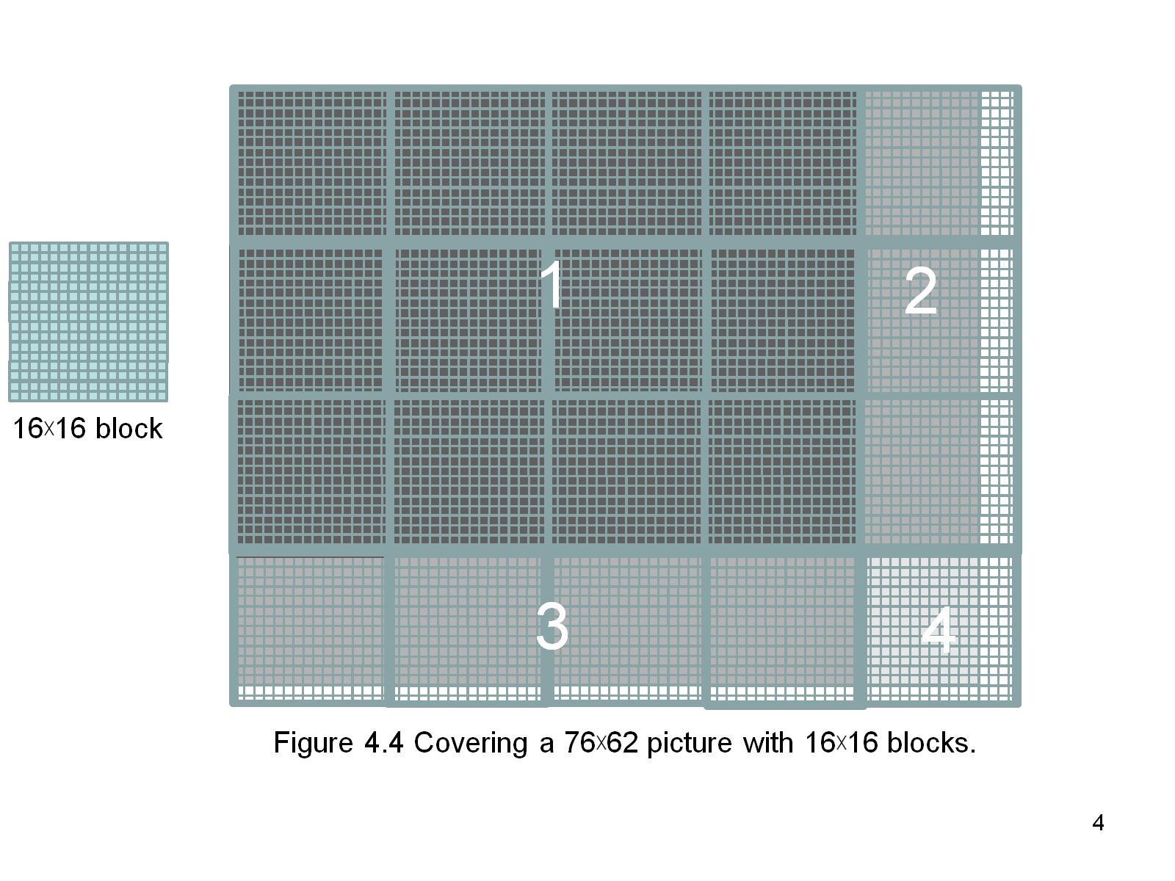
Covering a 62$×$76 Picture with 16$×$16 Blocks
Not all threads in a Block will follow the same control flow path.

Slide 37
Control Divergence
Control divergence occurs when threads in a warp take different control flow paths by making different control decisions
  Some take the then-path and others take the else-path of an if-statement
  Some threads take different number of loop iterations than others
The execution of threads taking different paths are serialized in current GPUs
  The control paths taken by the threads in a warp are traversed one at a time until there is no more.
  During the execution of each path, all threads taking that path will be executed in parallel
  The number of different paths can be large when considering nested control flow statements
Notes:
WARP_SIZE

Slide 38
Control Divergence Examples
Divergence can arise when branch or loop condition is a function of thread indices
Example kernel statement with divergence:
  if (threadIdx.x > 2) { }
  This creates two different control paths for threads in a block
  Decision granularity < warp size; threads 0, 1 and 2 follow different path than the rest of the threads in the first warp
Example without divergence:
  If (blockIdx.x > 2) { }
  Decision granularity is a multiple of blocks size; all threads in any given warp follow the same path

Slide 39
What Block Size Should I Use??
For 2D algorithms using multiple blocks, should I use 8X8, 16X16 or 32X32 blocks for Fermi?
  For 8X8, we have 64 threads per Block. Since each SM can take up to 1536 threads, which translates to 24 Blocks. However, each SM can only take up to 8 Blocks, only 512 threads will go into each SM!
  For 16X16, we have 256 threads per Block. Since each SM can take up to 1536 threads, it can take up to 6 Blocks and achieve full capacity unless other resource considerations overrule.
  For 32X32, we would have 1024 threads per Block. Only one block can fit into an SM for Fermi. Using only 2/3 of the thread capacity of an SM.

Slide 40


RGB to Grayscale Conversion
A grayscale digital image is an image in which the value of each pixel carries only intensity information.

Slide 41
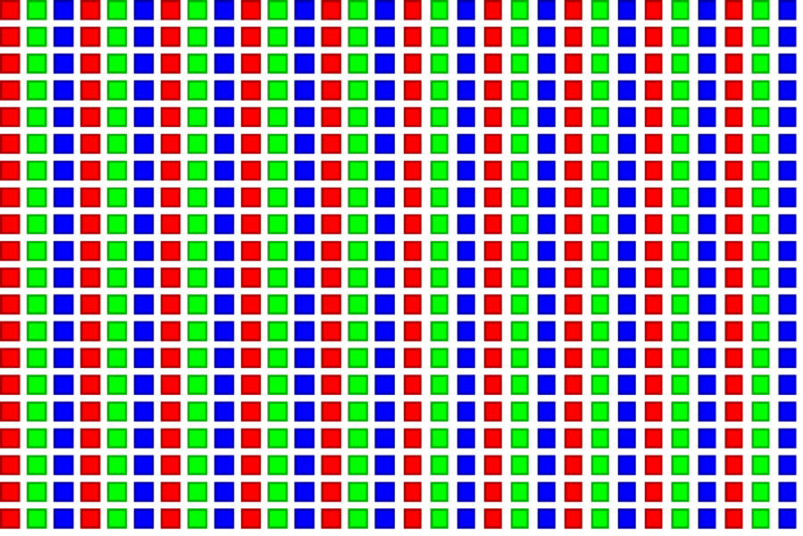
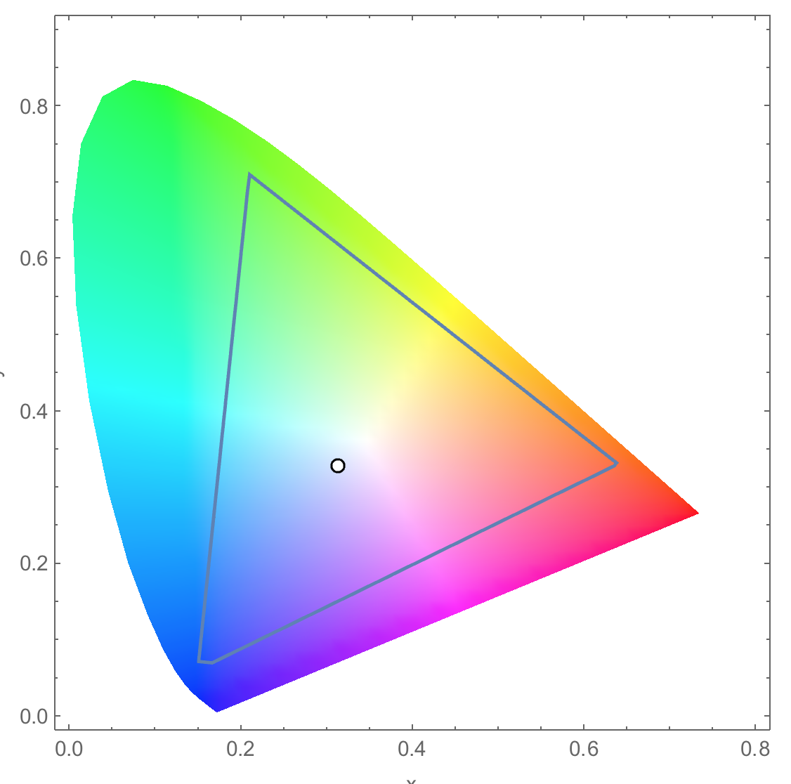
RGB Color Image Example
Each pixel in an image is an RGB value
The format of an image’s row is
(r g b) (r g b) … (r g b)
RGB ranges are not distributed uniformly
Many different color spaces, here we show the constants to convert to AdbobeRGB color space
  The vertical axis (y value) and horizontal axis (x value) show the fraction of the pixel intensity that should be allocated to G and B. The remaining fraction (1-y–x) of the pixel intensity that should be assigned to R
  The triangle contains all the representable colors in this color space

Slide 42
Color Calculating Formula
For each pixel (r g b) at (I, J) do:
grayPixel[I,J] = 0.21*r + 0.71*g + 0.07*b
This is just a dot product <[r,g,b],[0.21,0.71,0.07]> with the constants being specific to input RGB space
0.71
0.21
0.07

Slide 43
#define CHANNELS 3 // we have 3 channels corresponding to RGB
// The input image is encoded as unsigned characters [0, 255]
__global__ void colorConvert(unsigned char * grayImage,unsigned char * rgbImage, int width, int height)
{
int x = threadIdx.x + blockIdx.x * blockDim.x;
int y = threadIdx.y + blockIdx.y * blockDim.y;
if (x < width && y < height) {
// get 1D coordinate for the grayscale image
int grayOffset = y*width + x;
// one can think of the RGB image having
// CHANNEL times columns than the gray scale image
int rgbOffset = grayOffset*CHANNELS;
unsigned char r = rgbImage[rgbOffset ]; // red value for pixel
unsigned char g = rgbImage[rgbOffset + 1]; // green value for pixel
unsigned char b = rgbImage[rgbOffset + 2]; // blue value for pixel
// perform the rescaling and store it
// We multiply by floating point constants
grayImage[grayOffset] = 0.21f*r + 0.71f*g + 0.07f*b;
}
}

Slide 44

Notes:
Poll Title: How can you reduce warp divergence a program?
https://www.polleverywhere.com/free_text_polls/1dobHLMencbO13n5JmZ6I

